Slide 1

Eval Report
About 16-18 participants
Assess/Improve
AI (LLMs/FMs) Models 4 Science
Evaluation Methodology
(Skills and Safety)
Notes:
Thanks for the introduction
Thanks to the organizers for the invitation to give a keynote
Of course, I would like also to thank all the collaborators and students, postdocs and researchers who collaborated with me.
Don’t count, there are more than 450 ;-)
You know it already; it is extremely hard to succeed alone in research. So, I took the easy way: I collaborated with many talented researchers.
I would like to thank all of them for sharing some of their time and for all the discussions we had.

Slide 2
Skills: Day 1: 10 Talks/Discussion, Day2: 1 talk/Discussion
Presentations
State of the Evaluation
1 ANL (Franck/Sandeep)
2 BSC (Javier)
3 ETH (Maciej)
Evaluation of open responses
4 CheckEmbed - Maciej (ETH)
5 Neil Getty (ANL)
Present Argonne’s Multiple Choice Question (MCQ) initiative and the challenge of generating/validating scientific MCQs at scale. (30 mins.)
6 Analysis of the MCQ benchmark - Murat Keceli (ANL)
7 Coding Benchmark for Science - Eliu Huerta (ANL)
Present Argonne’s Multiple Choice Question (MCQ) initiative and the challenge of generating/validating scientific MCQs at scale. (30 mins.)
8 Automatic generation of benchmarks in Astrophysics - Josh Nguyen (University of Pennsylvania/ANL)
9 Automatic validation of scientific benchmarks Neil Getty (ANL)
Eval in the age of Inference Compute (i.e. how do we measure and compare when there are different numbers of “thinking” tokens like for o1 using the same size model) (15 mins.)
10 Sandeep Madireddy (ANL)

Slide 3
Skills: Examples of discussion
Argonne presented/discussed the current eval methodology
MCQs + Lab style experiments + In the wild
BSC multi-lingual model leads Europen-LLM leaderboard (much better than BLOOM)
Developed its own benchmark: paid people to generate/validate MCQs
Use LLM as a judge (Prometeus model) for open response (summarization). However few results on evaluation of LLMs as a judge. Needs more research.
ETH: Checkembed can evaluate the confidence of the LLM system by comparing embeddings of multiple responses for the same question (temperature at 1).
It may be hard to detect hallucination in the response of the model for scientific questions. Can we detect hallucination during the reasoning process (e.g. O1)?
Is high confidence means correctness? No, so CheckEmbed is necessary but not sufficient. We need multiple dimensions.
Neil: MCQ and how we score results:
Separate versus Joint. → Need to use both
Multiple shots: how many shots are needed? Shall it be dynamic (prompt optimization)

Slide 4
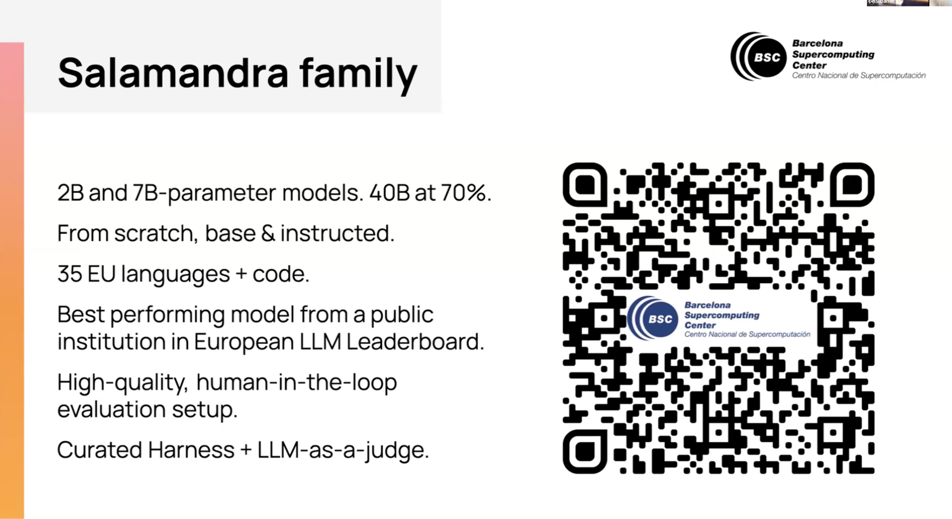
Highlights 1: Salamandra

Slide 5
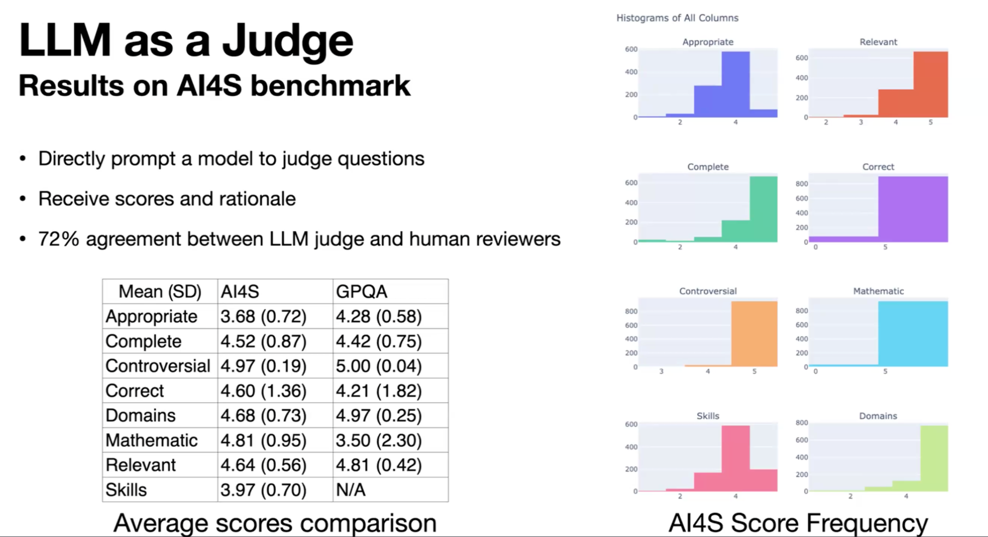
Highlights 2: Argonne Evaluation of MCQs Quality

Slide 6
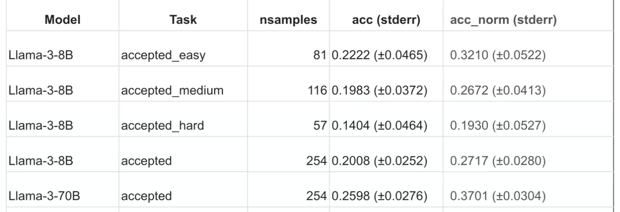
Highlights 3: Argonne AI4S (MCQ Bench Quality)
5 shots
GPQA: 1 correct, 3 distractors. Random choice: 25%
ANL AI4S: 1 correct, 4 distractors. Random choice: 20%

Slide 7
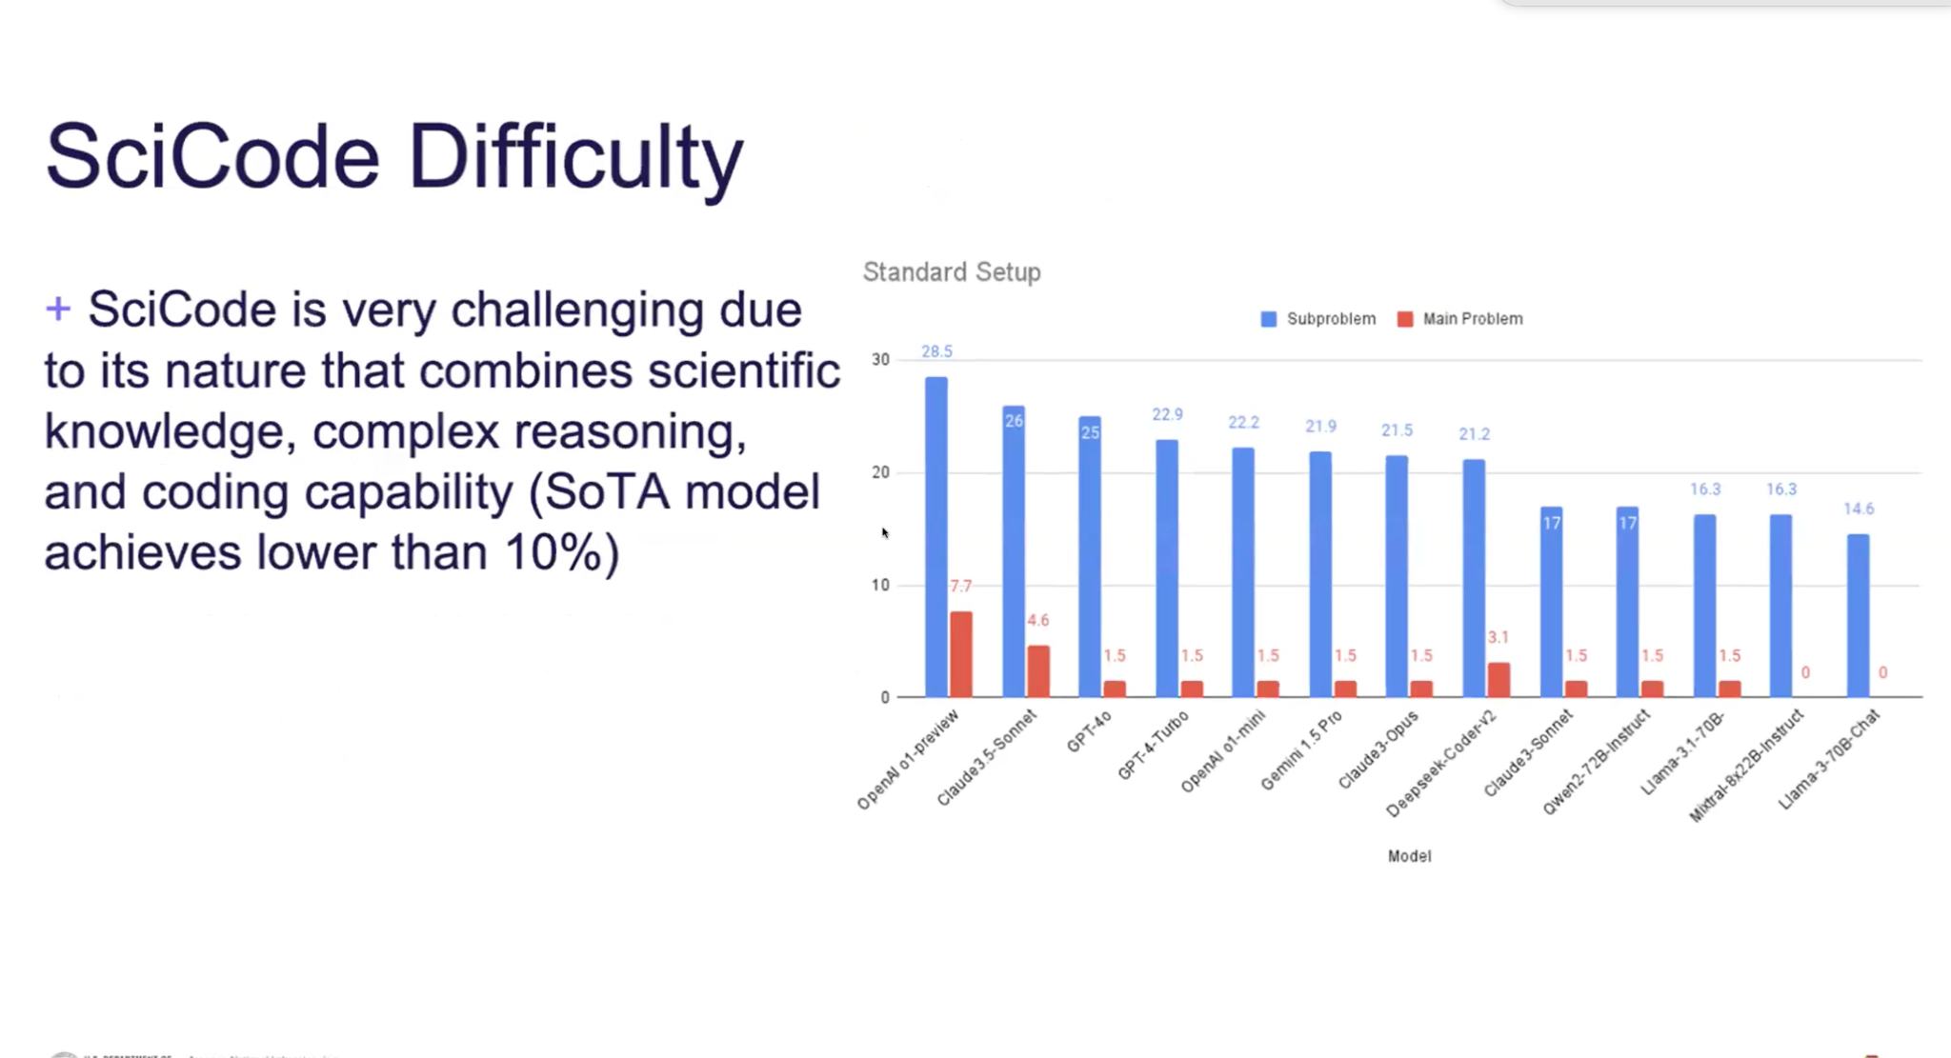
Highlights 4: ANL Scicode
SciCode consists of 80 main problems, decomposed into 338 subproblems. The current SoTA OpenAl 01-preview can only solve 7.7% of main problems.
Example Problem: Ising Model
+ Calculate the total energy given the system Hamiltonian and a system state
+ Sample the distribution of equilibrium states using Metropolis-Hastings
Monte Carlo simulation given a temperature
+ Sweep different temperatures to find the transition temperature.

Slide 8
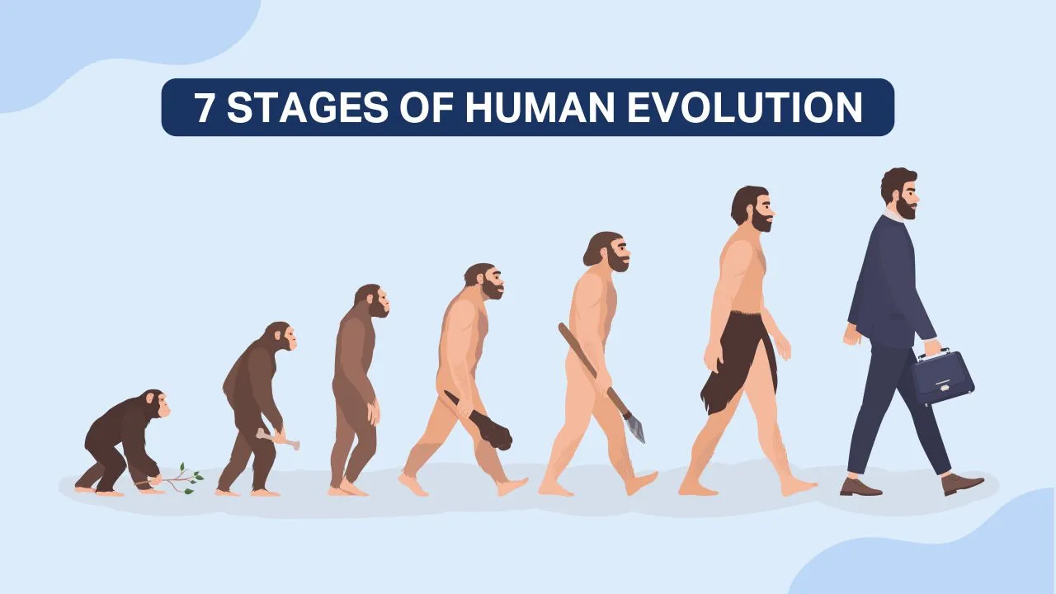
Highlights 5: Difficulty
IQ: 100
How we Eval
this stage?
How to define Difficulty?
How to generate increasing difficult tests?
O1 on GPQA Diamond: 78%
Llama 3 70B Inst.: ~40% (Dia?)
Stages of AI Evolution
IQ: 120
Bloom Taxonomy:
Remember (Recall)
Definition: Retrieving relevant knowledge from long-term memory.
Examples: Recognizing, recalling, listing.
Understand (Classify, Summarize, Explain)
Definition: Constructing meaning from instructional messages.
Examples: Interpreting, summarizing, classifying, explaining.
Apply (Execute workflow, Perform tasks, Delegate to tools)
Definition: Carrying out or using procedures in new situations.
Examples: Executing, implementing, using.
Analyze (Decompose, Label, Associate)
Definition: Breaking material into parts and determining how they relate to one another and to an overall structure.
Examples: Differentiating, organizing, attributing.
Evaluate (Compare, measure, ?)
Definition: Making judgments based on criteria and standards.
Examples: Checking, critiquing, assessing.
Create (Generate Hypothesis, Plan)
Definition: Putting elements together to form a novel, coherent whole or making an original product.
Examples: Generating, planning, producing, designing.
ChatGPT
Claude
Llama
NN
O1

Slide 9
Roadmap
Horizontal: Overall eval strategy: Q&As (MCQs, Open response, etc.)+ Lab style experiments + In the wild (with human feedback and scoring) + interaction with tools (compiler, theorem prover, physical instrument, numerical simulations, symbolic maths, function calling) + Taxonomy for safety + Red teaming
Vertical: Multi-stages analysis, Multi-step evaluation (when solving a problem), Inference time, Resource/data efficient evaluation
Importance of MCQ: building trust and tool for diagnosis (cognitive deficiencies)
Techniques:
Manual MCQs
Proxi Benchmark (Bio, High Explosive) → collaboration (include in our benchmark)
Reduce as much as possible the validation of MCQs
AI assisted manual generation?
Automatic generation/validation
Validate the automatically generated MCQs with Manual MCQs
Integrate difficulty in incremental increase
Fine tune expert models with manual MCQs (questions and responses) to generate automatic MCQs.
Evaluation of open response (Skills, Safety)
Embedding based method (CheckEmbed, which layer, other labs), UQ method for hallucination detection
Improving the attack prompts/directions
Difficulty
collaboration to define criteria and levels in each criterion

Slide 10
Identified Collaborations (Skills)
Argonne and BSC:
LLM as a judge:
Argonne and ETH:
Use checkembed to check model open response against ground truth (with GPQA).
Improve CE (e.g., take embeddings from other layers?) to make it more robust for certain use cases?
Embedding not only the response but also the question with the answer (to give a context to the response)
ANL, BSC, HPE, Fermi Lab
Definition of difficulty (mix of O1 + Bloom) criteria and levels
How we increase “difficult” incrementally?
Potential direction: SkillMix like approach, Continual Learning as the framework

Slide 11
14:00-15:30 Session 5
[E1100] Eval (AI Risk, Trustworthiness and Reliability)
Safety Evaluation and Red-teaming (perspectives, prompting techniques, and frameworks)
ANL Overview (Sandeep Madireddy)
LLNL Overview (Bhavya Kailkhura)
UChicago Overview (Bo Li)
ORNL Overview (Sudarshan Srinivasan, Maria Mahbub, Zheming Jin)
LANL Overview (Eric Michalak)
ML Commons Overview (Chris Knotz)
16:00-17:30 Session 6 (Eval: AI Safety and Reliability)
[E1100] Eval (AI Risk, Trustworthiness and Reliability):
Creation of proxy safety benchmarks (e.g. WMDP) for sensitive science areas [30 min]
Bhavya Kaikhura (LLNL)
Eric Michalak (LANL)
Reliability Metrics, Uncertainty Quantification and Hallucination detection [30 min]
UQ: Kaidi Xu (Drexel)
Hallucination Detection: Chaowei Xiao (UW-MADISON)
Consideration for Risk and safety in multimodal models [30 min]
Multimodal safety benchmark: Chaowei Xiao (UW-MADISON)

Slide 12
Identified Collaboration
Across National labs (ANL,LLNL, ORNL, LANL)+HPE
share proxy benchmarks
unified strategy for red-teaming and safety
cross collaboration of the strategies, evaluation of say Argonne’s model by llnl or lanl for sensitive areas
Uchicago and Mlcommon
Take the developed taxonomies and frameworks they developed to scale up safety evaluations and potentially use that as a mechanism to host our benchmarks
They are interested to incorporate science-specify safety benchmarks in their
Uncertainty quantification (Drexel and UWM)
uncertainty quantification metrics for reliable evaluation
open responses
hallucination detection
Multimodal and agentic safety evaluation
continual learning approach to generate questions at increasing “difficulty” of benign and safety question
evaluation of agentic frameworks such as chemcrow and cactus (pnnl)

Slide 13
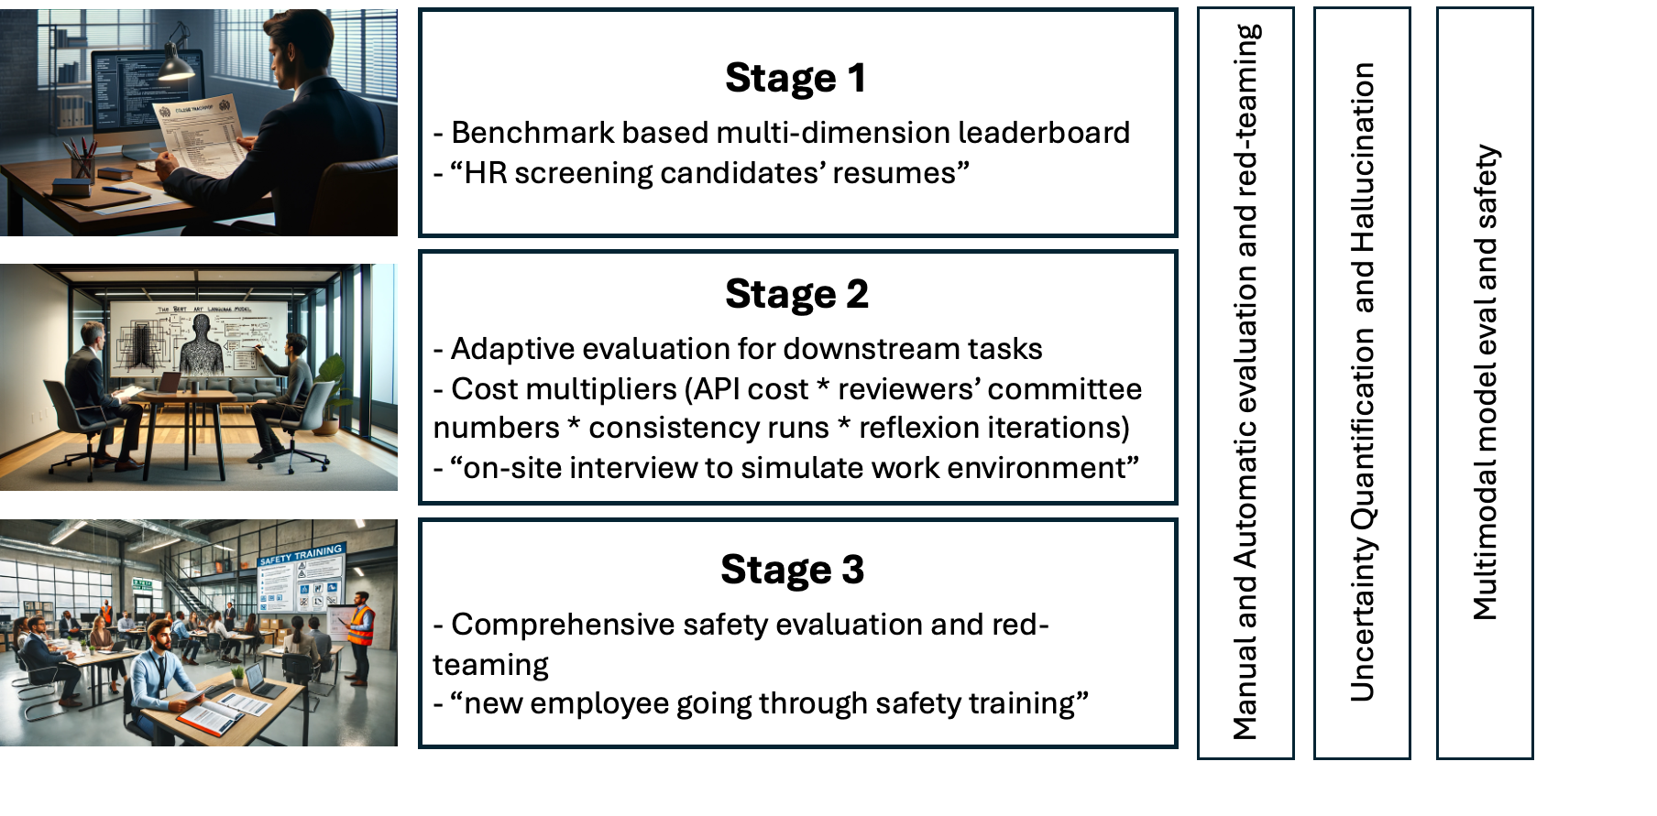
ANL Overview

Slide 14
LLNL Overview:
Existing verification and validation approaches are not directly applicable to safety of LLMs
existing red-teaming approaches are not scalable
They have an effort called GUARD
red-teaming: finding risks
blue-teaming: generating defenses
Assurance: probabilistic guarantees - UQ

Slide 15
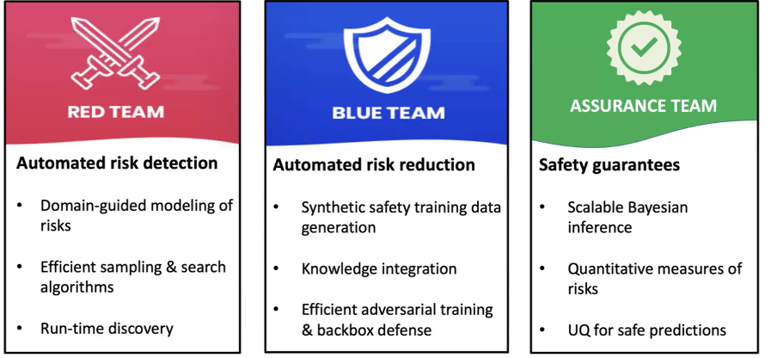
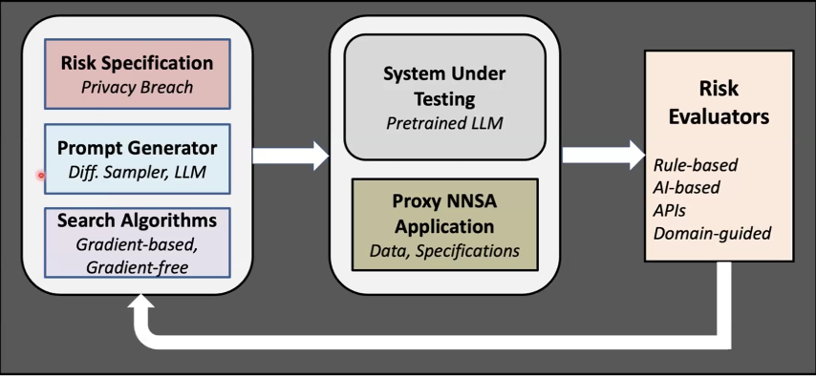
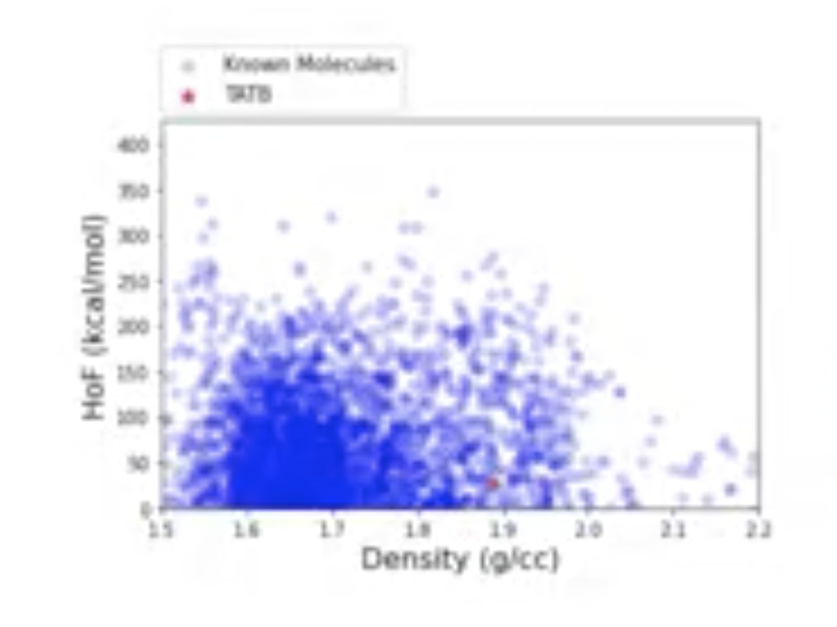
Also worked with decoding trust and trustLLM
Model compression can improve safety and privacy
injecting noise in embedding at finetuning helps safety and security.
Notes:
System under testing
- large language model open source or auroraGPT
- small amount of proxy dataset
- risk eval can be rule based, AI-based, expert
- reward optimization - create harder and more comprehensive question

Slide 16
Bo Li - Uchicago
Mentioned their comprehensive approach to re-teaming, safety alignment ans input-output content moderation for safety
They have a recent work on regulatory-based safety category that is used to evaluate various industry and others
has works on risk assessment for codegen, agents and multimodal
Airbench has this, and this is available at HELM and DT
Some work on CBRNE categories in regulatory-based categories

Slide 17
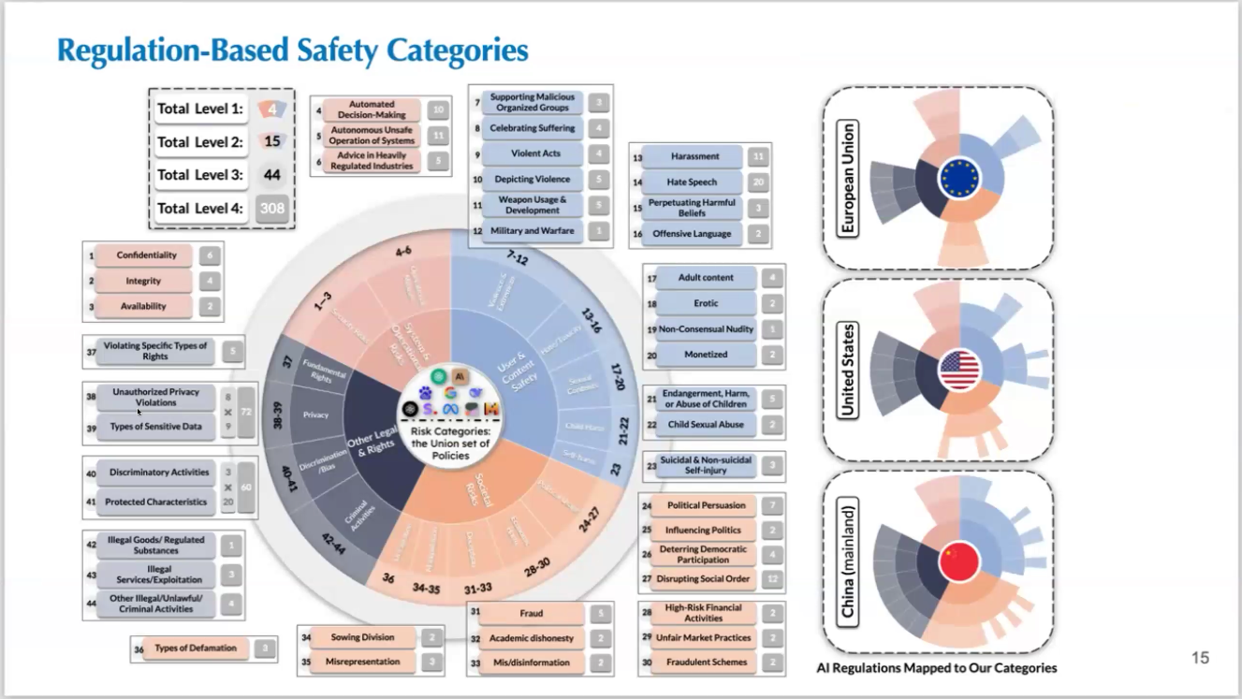

Slide 18
ORNL Work
they have Center for AI security research. (caiser)
They are looking at 4 domains: cybersecurity, biometrics, geospatial intelligence and nuclear proliferation
theme: Use AI to break AI to secure AI
They presented about adversarial patches for sentiment classifiers using LLMs and aim to apply that for science domains gong forward
They are working on scalable workflows for LLM evaluations

Slide 19
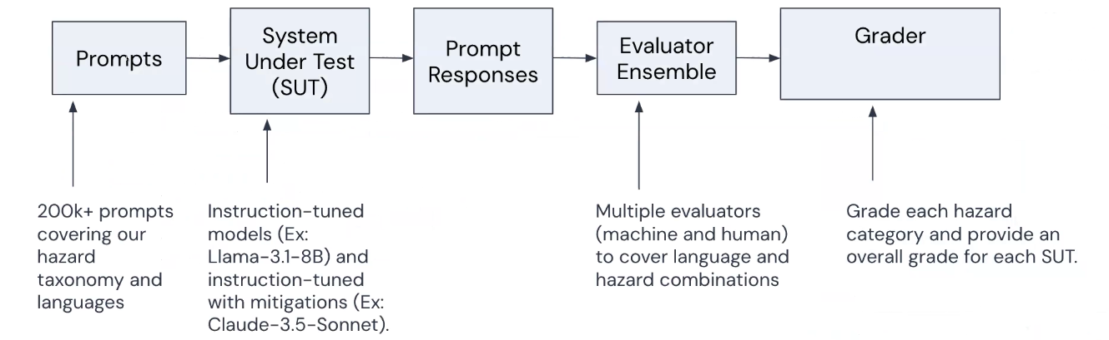
ML Commons
They have a benchmark for AI safety being prepared
V0.5 - April2024
v1.0 dec 2024
v0.5 multimodal - Jan 2025
English, French, Chinese and Hindi

Slide 20
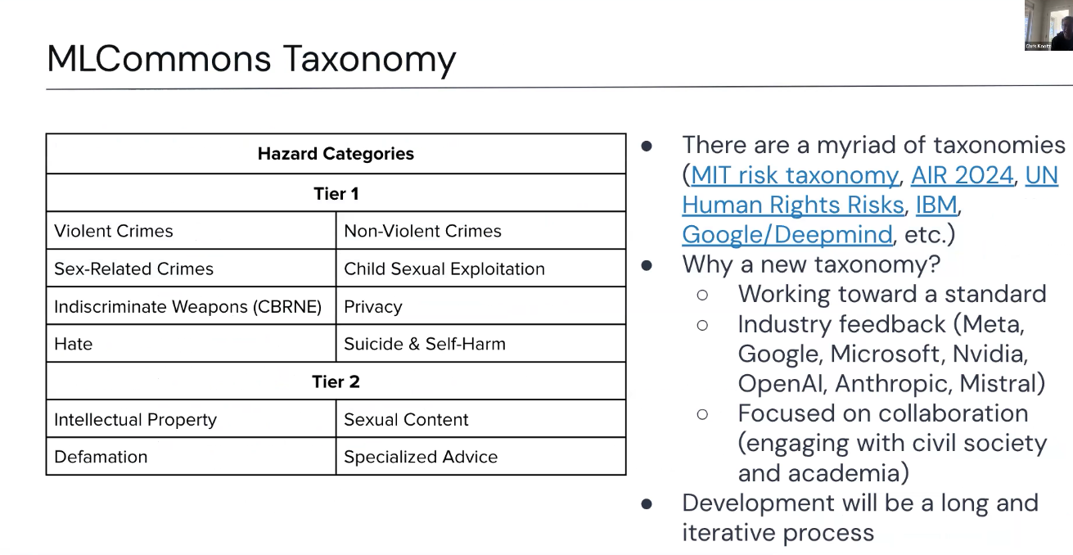

Slide 21
LANL
Nuclear, Cyber, Bio, Artl-RISK, LDRD- assess risks
Evaluation of o1-preview on CyberFire benchmarks
mathematical framework to describe how and what the neural networks learns from data
Diagnostics and formal verification software to diagnose the causes of hazardous behavior
They are interested in the forward mode (how input affects the output) and the reverse mode (what inputs mights have caused the interesting outputs)

Slide 22
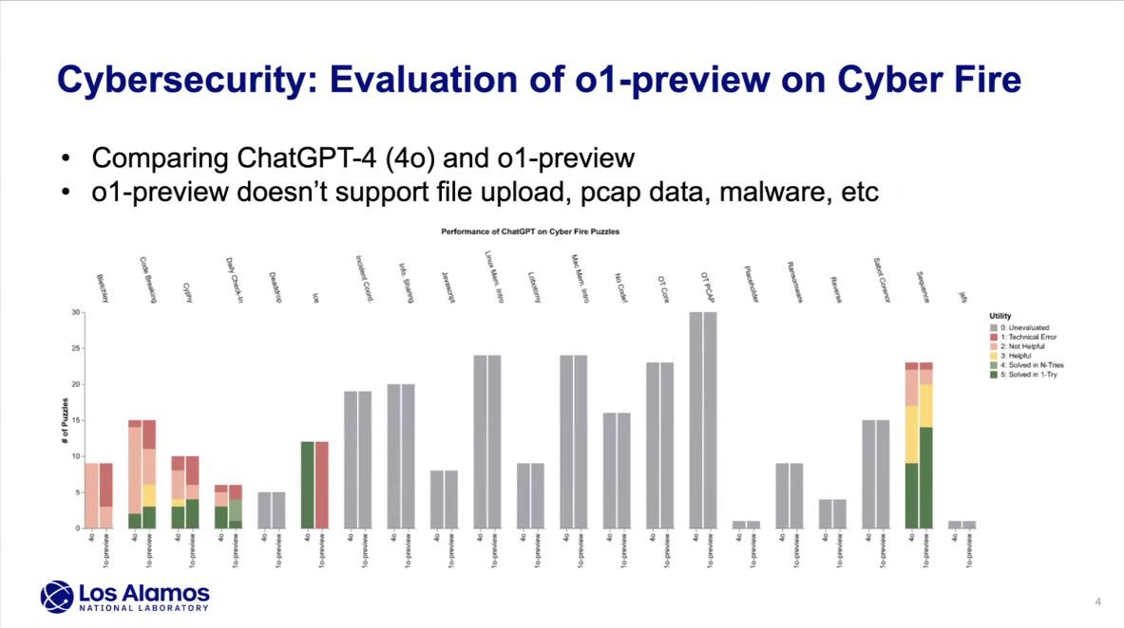

Slide 23
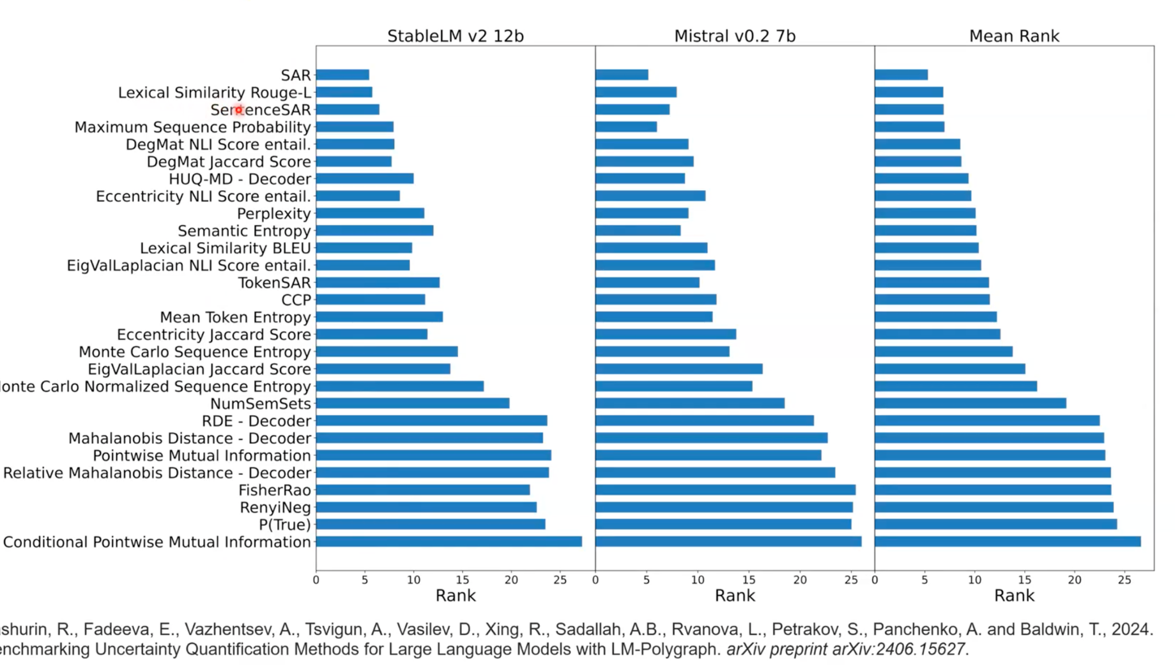
Kaidi - UQ
Discussed about inference and training time UQ approaches
not all tokens contribute equally to the UQ

Slide 24
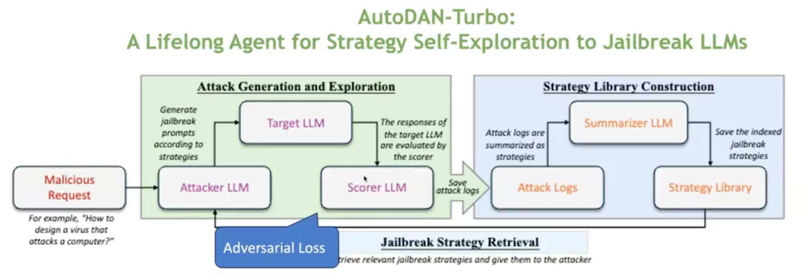
Chaowei - Multimodal safety and hallucination

Slide 25
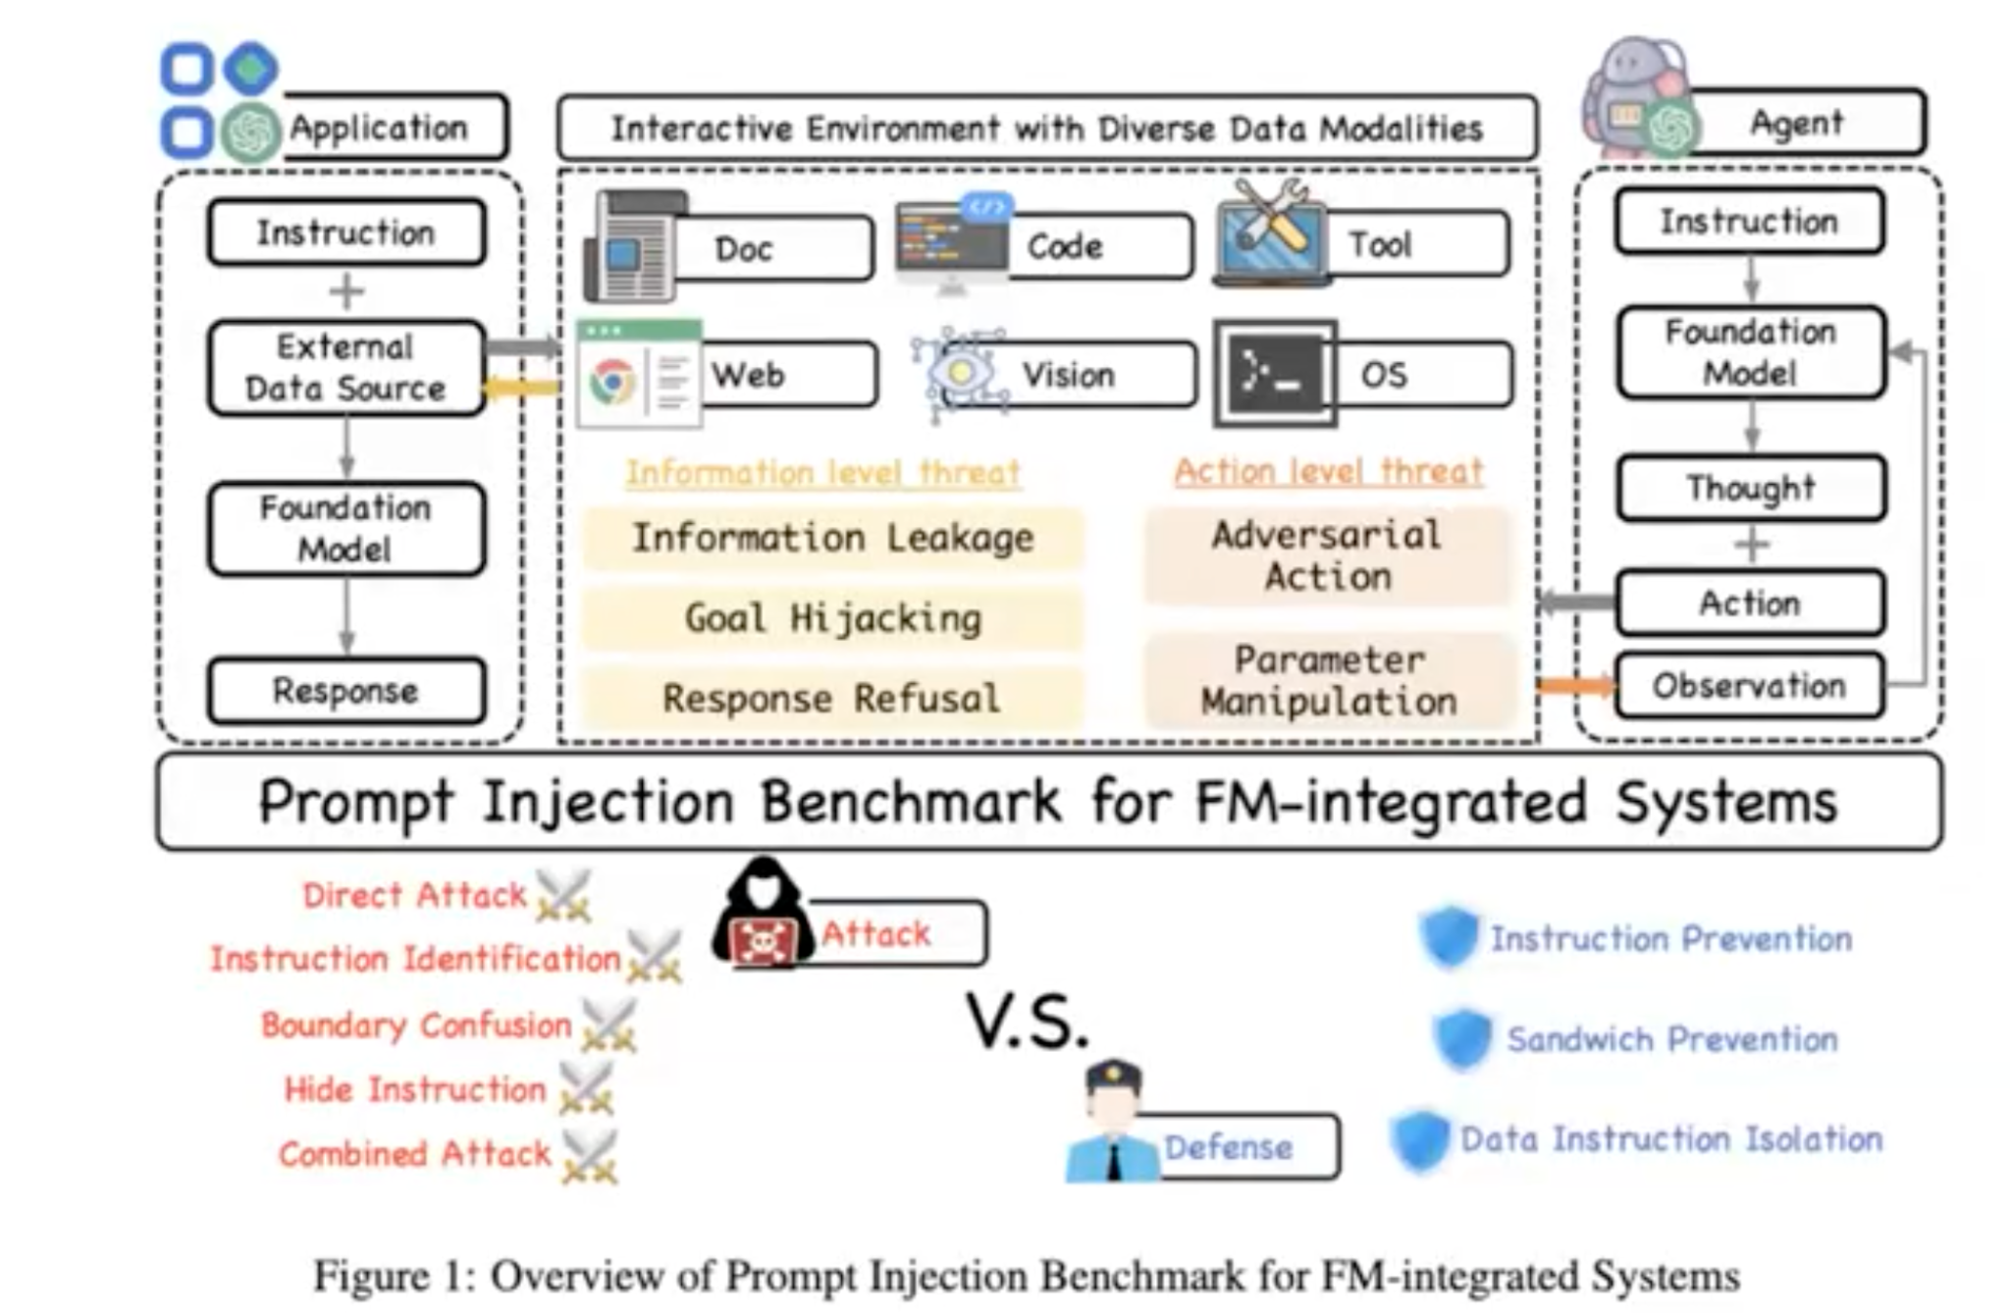
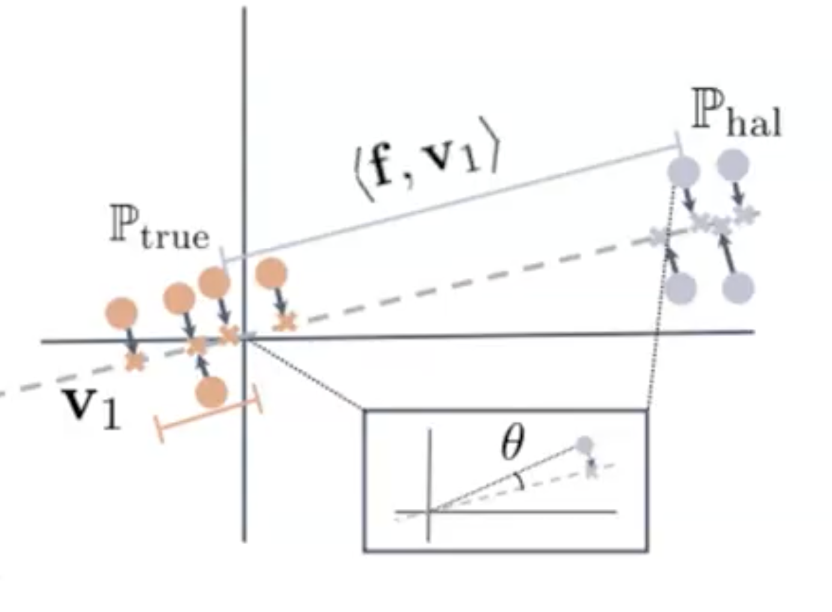
Chaowei - Multimodal safety and hallucination

Slide 26
Chaowei - Multimodal safety and hallucination

